Slide 1

On The Instability of Sensor Orientation in Gait Verification on Mobile Phone
Thang Hoang†, Deokjai Choi†, Thuc Nguyen‡
† Faculty of Information Technology, Saigon Technology University, Vietnam
thang.hoangminh@stu.edu.vn
† Dept. of Electronics & Computer Engineering, Chonnam National University, South Korea
dchoi@jnu.ac.kr
‡ Faculty of Information Technology, Ho Chi Minh University of Science VNU-HCMC, Vietnam
ndthuc@fit.hcmus.edu.vn

Slide 2
Outline
Introduction
Motivation & Contributions
Proposed Methods
Solution for The Instability of Sensor Orientation
Machine-Learning Based Gait Verification Model
Experiments
Conclusion

Slide 3
Introduction
The number of mobile subscriptions is forecasted to reach 9.3 billion by 2019, 5.6 billion of which will be for smart phones.
Personal data have being accumulated more and more in the mobile phone.
→ Sensitive data inside are becoming more vulnerable to be illegally exploited!.
Well-known authentication methods
Secret key (PIN, passwords, visual patterns)
Philological biometrics (face, fingerprint)
Limitations
Password management (remembrance, storage)
Imitation of biometric samples
Obtrusive in frequent use

Slide 4
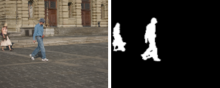
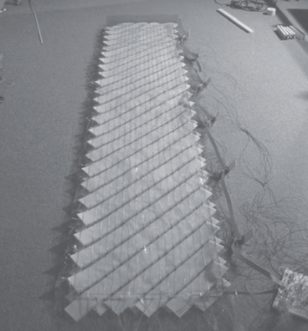
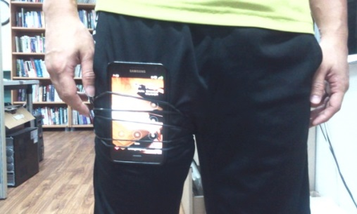
Motivation
Gait has been introduced as an effective behavioral biometrics which is difficult to be counterfeited.
Typical gait-based authentication techniques
Several wearable sensor based gait authentication schemes have been proposed since 2005 [1].
Sensors used: 2D/3D accelerometer, gyroscope sensor, orientation sensor
Potential drawbacks!!
Ideal acquisition environment (e.g., sensor is always fixed)
High error rates (~ 10 – 20%)
1. Machine Vision Based
2. Floor Sensor Based
3. Wearable Sensor Based

Slide 5
Contributions
Overcome the instability of sensor orientation during data acquisition
The device can be put freely in the pocket → more practical
Propose a novel Machine Learning-based gait recognition scheme for verification/ identification
Enhance the accuracy rates
Limitation
The major location of the device stills need to be fixed

Slide 6
The Instability of Sensor Orientation
Problem statement
The shape of gait signals acquired by 3D accelerometer depends on the relative orientation between the mobile and its carrier
Fig. 1. (a) Mobile coordinate system, (b) minor misplacement, (c) disorientation error and (d) both cases
Sensor disorientation makes the acquired signals in each separate dimension dissimilar.

Slide 7
The Instability of Sensor Orientation
Problem statement
Example:
Session 2
Session 3
Session 1
Gait signal of the same subject walking in 3 sessions with different sensor orientation setup.

Slide 8
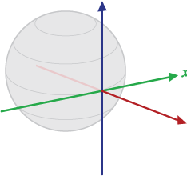
The Instability of Sensor Orientation
Solution
Representing gait signals from the instable coordinate system (mobile phone) to a stable one
Earth is selected to be the fixed coordinate system

Slide 9





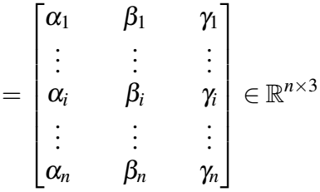

The Instability of Sensor Orientation
Solution
Types of sensor data need to be acquired:
Acceleration data (accelerometer)
Orientation data (orientation sensor)
Gravitational acceleration data (gravity sensor)
Data collected after a walking session

Slide 10


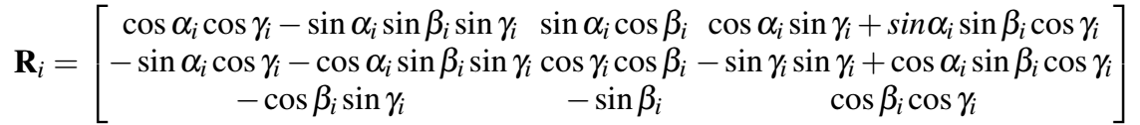
The Instability of Sensor Orientation
Solution
1. Remove gravitational acceleration components in the gait signals
2. Transform the gravity-free signal to the Earth coordinate system
where $R_{i}$ is the rotation matrix calculated from each rotation vector $o_{i}$ by

Slide 11
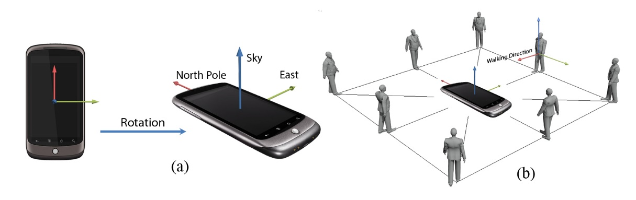
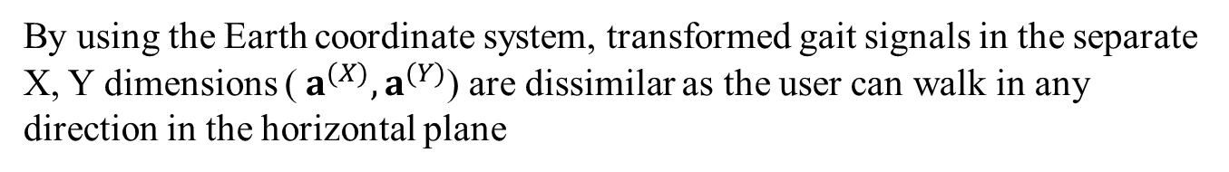
The Instability of Sensor Orientation
Problem
By using the Earth coordinate system, transformed gait signals in the separate X, Y dimensions (${ a}^{(X)},a^{(Y)}$) are dissimilar as the user can walk in any direction in the horizontal plane

Slide 12




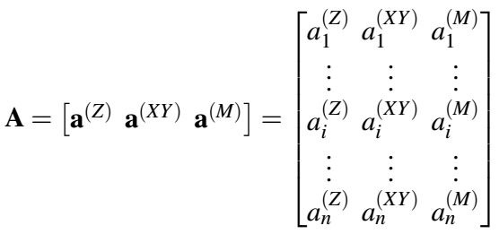
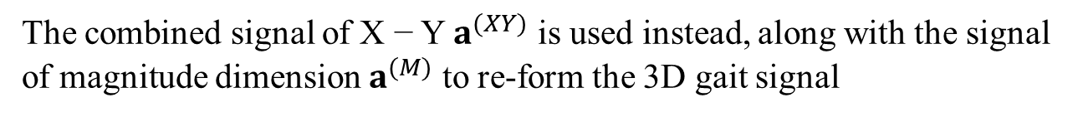
The Instability of Sensor Orientation
Solution
The combined signal of X − Y $a^{(XY)}$ is used instead, along with the signal of magnitude dimension $a^{(M)}$ to re-form the 3D gait signal
,
where
,
Finally, the gait signal after transformation will be presented in 3 dimensions which are immune to the disorientation of the sensor

Slide 13
ML-Based Gait Recognition Model
Data acquisition
Interpolation
Linear Interpolation
Noise Elimination
Daubechies wavelet decomposition
Signal Transformation
Preprocessing
Verification/ Identification Decision
Verf/ Iden
Segmentation
User Model
Feature Extraction
Verf/ Iden
Feature Vector Dimension Reduction
Classification
Enrollment

Slide 14
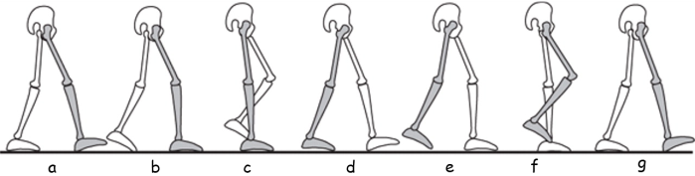
Segmentation
Gait cycle-based segmentation
According to two criteria: acceleration magnitude and the length of each gait cycle
Fig. 4. Illustration of a gait cycle
Autocorrelation coefficients ct (0 ≤ t < n) of the Z−dimension signal
Detected marking points in Z−dimension signal

Slide 15
Segmentation
Pattern #3
Gait Pattern Extraction
4-gait-cycle segments, overlapped 50% with the previous one
extraction
Pattern #2
extraction
extraction
Pattern #1

Slide 16
Feature Extraction
Time domain: Statistical analysis
Mean of the max/min value;
Average absolute difference;
Root mean square;
Standard deviation;
waveform length;
10-bin histogram distribution;
Average length of gait cycles
Frequency domain
Magnitudes of first 40 FFT coefficients
First 40 DCT coefficients

Slide 17
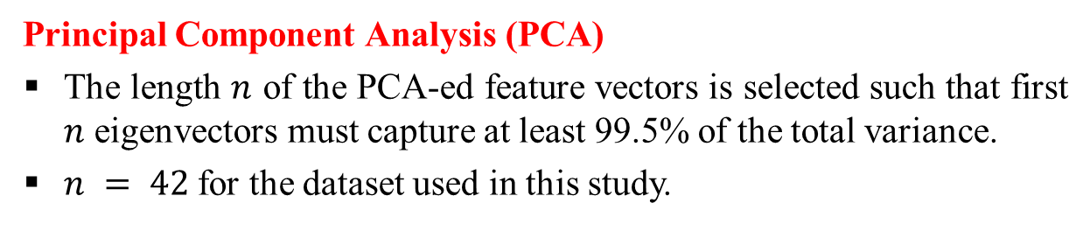
Feature Vector Dimension Reduction
Objective
Increase the learning time while maintaining the discriminability of the gait feature vectors
→ Lighten the system to make it runnable on constraint devices
Principal Component Analysis (PCA)
The length $n$ of the PCA-ed feature vectors is selected such that first $n$ eigenvectors must capture at least 99.5% of the total variance.
$n = 42$for the dataset used in this study.

Slide 18
Classification
Two schemes:
Template matching: PCA
PCA-ed feature vectors are stored in the mobile storage for matching.
Supervised learning: SVM+PCA
Support Vector Machine (SVM) supervised learning: build the gait model.
libsvm opensource¹: simulate SVM learning and prediction.
¹Download available at https://www.csie.ntu.edu.tw/~cjlin/libsvm/

Slide 19
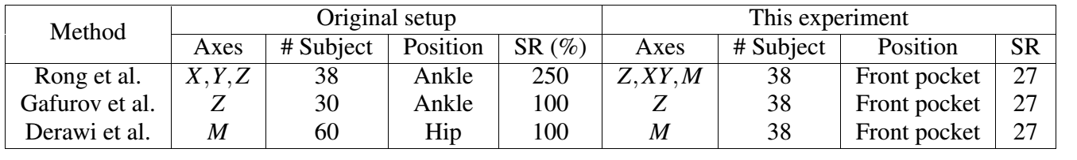
Experimental results
Configurations
Dataset: 38 subjects
Recording device: Google Nexus One, sampling rate: 27 Hz
# of gait patterns extracted: 10,000+
Re-implement related works [2-4] for evaluating the solution for disorientation problem and comparison to the proposed machine-learning approach
The configuration differences in between the original study and this experiment

Slide 20
Experimental results
Verification results
With different proportion of training/ testing data
PCA
SVM+PCA

Slide 21
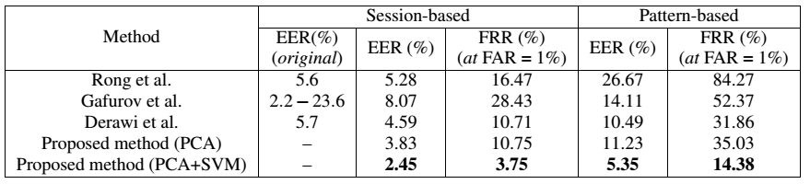
Experimental results
Verification results
Compare with other related works
Session-based verification
Pattern-based verification

Slide 22
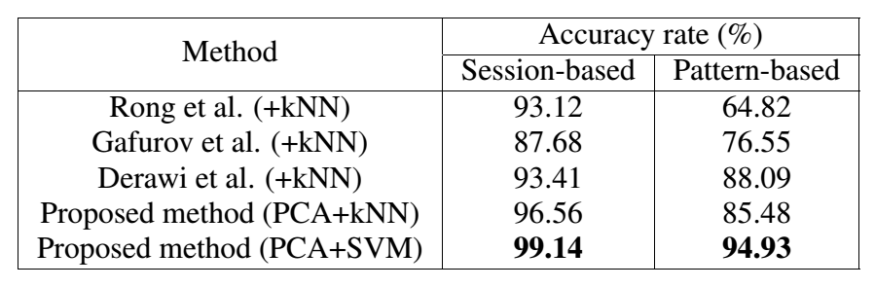
Experimental results
Verification results
Compare with other related works
k-NN is used to perform identification for all schemes, except the SVM+PCA scheme

Slide 23
Experimental results
The impact of disorientation error
Rong et al.
Gafurov et al.
Derawi et al.
The proposed method

Slide 24
Conclusions
Addressed the sensor disorientation problem
Not only useful for gait authentication but also effective for applications using 3D acceleration signals (activity recognition, fall detection, etc.)
Proposed an machine-learning based gait recognition scheme
Drawbacks!
The phone location is not flexible.
Potential vulnerability: User gait model and templates are stored insecurely in mobile storage (critical!!!).
Current & further works
Independent location of the device.
Biometric gait template protection

Slide 25
References
Ailisto, H. (2005). Identifying people from gait pattern with accelerometers. In Defense and Security. SPIE.
Derawi, M. et al. (2010a). Improved cycle detection for accelerometer based gait authentication. In In Intelligent Information Hiding and Multimedia Signal Processing (IIH-MSP). IEEE.
Gafurov, D. et al. (2010). Improved gait recognition performance using cycle matching. In Advanced Information Networking and Applications Workshops (WAINA), 2010 IEEE 24th International Conference on. IEEE.
Rong, L. et al. (2007). A wearable acceleration sensor system for gait recognition. In Industrial Electronics and Applications, 2007. ICIEA 2007. 2nd IEEE Conference on. IEEE.

Slide 26
Q&A
Thanks for listening!
Question?

